Slide 1
MIE 1622
Group Course Project
Short-term Investment Planner Chatbot
Group 9
Junyu Jiang
Yijia Gao
Yinjie Meng
Zijie Zhao
Ren Li
Notes:
Hi we are Group 9, today we are going to show you our short-term investment planner chatbot.

Slide 2




Outline
Business Overview
Chatbot Assistant
Decision Maker “Orion”
Results
Notes:
This is our outline for today, We will walk you through: the business overview of our chatbot design, showing the chatbot assistant process flow, demonstrate the detailed decision maker algorithm called “orion” and the results for different use cases.

Slide 3

01
Business Overview
Notes:
Part one, business overview

Slide 4

Introduction of Short-term Investment Planner Chatbot
Functions
Objectives
Constraints
· The automated investment advising interface can be easily accessed
· Forecasting results can be easily viewed and compared
· Consider flexibility on asset inclusion
(users with or with prior investment knowledge)
· Automatic short-term investment plans based on user needs
· Simulate future money-on-hand at the end of holding period
· All inputs must be entered in the similar format as required by the robot
Notes:
For this project, we have defined the functions, objectives and constraints of the chatbot design.
Its main functions is to
provide automatic short-term investment plan with user preferences on assets, holding period, amount and risk tolerance.
It should Simulate future money-on-hand at the end of holding period.
The objectives are that
The interface can be easily accessed.
Forecasting results can be easily viewed and compared,
It can consider flexibility on asset inclusion for both users with or without prior investment knowledge.
Lastly, constraint of the design is that All inputs must be entered in the similar format as required.

Slide 5
02
Chatbot Assistant System
Notes:
For the second part, we will talk about the chatbot assistant system

Slide 6
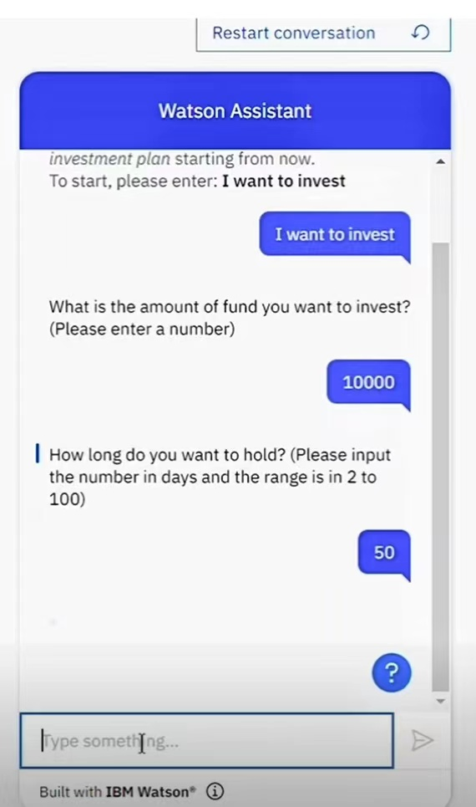
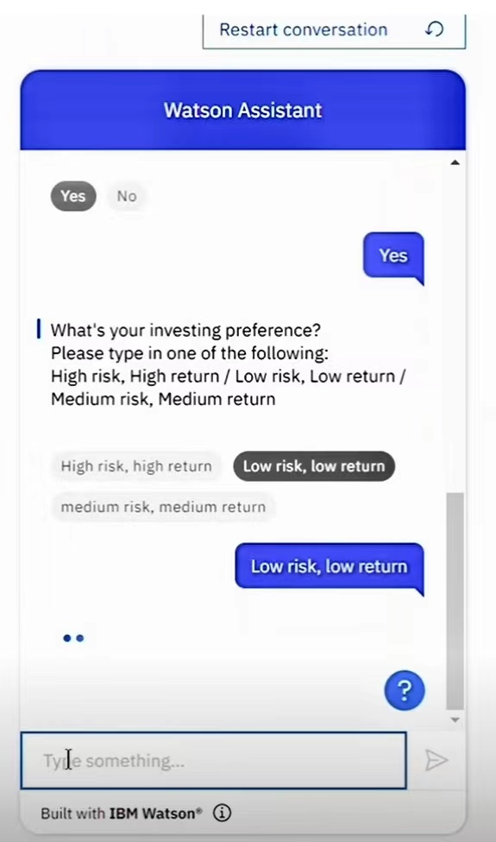
Chatbot Assistant System
Robo-advisor provides investing suggestions for short-term investing (the holding period is fewer than 100 days).
Robo-advisors can automatically guide potential customers to tell the chatbot:
Amount to invest
Holding period
Assets they want to invest
Risk tolerance level
Unique features:
Allows own preferences
Otherwise, a fixed choice of ETFs chosen by our system
Notes:
We designed a robo-advisor that provides investing suggestions for short-term investing (the holding period is fewer than 100 days). The main idea of this system is that it guides potential customers to tell the chatbot the amount of money they want to invest, the holding period, the assets they want to invest and their risk tolerance level.

Slide 7
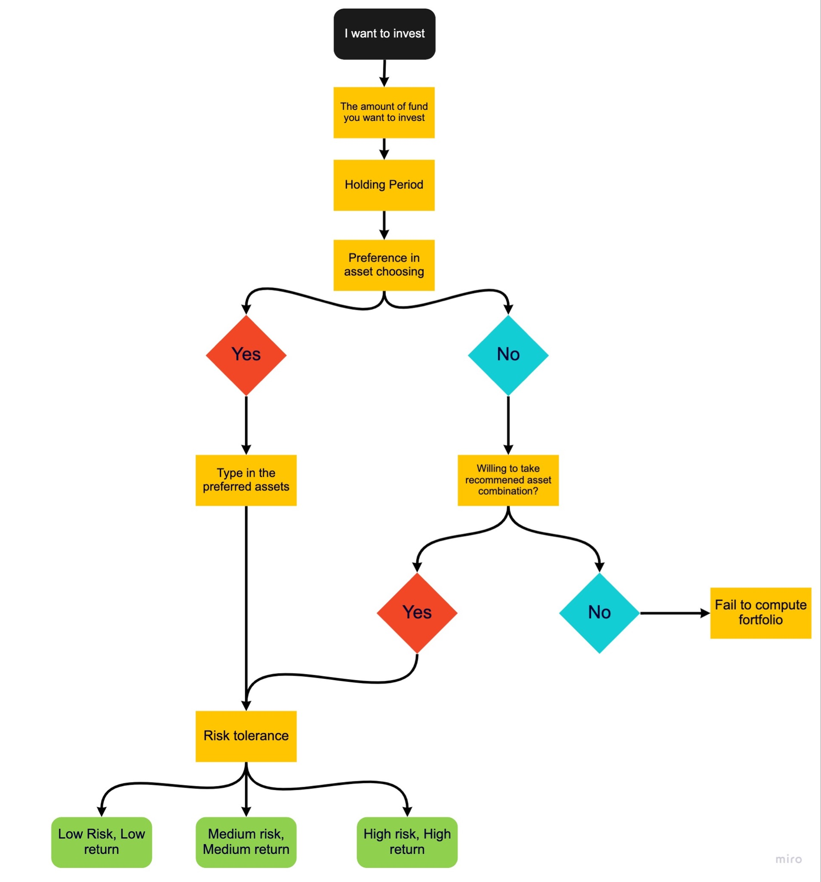
Chatbot by following the logic of the system
The video demo for chatbot
Notes:
The flow chart of the questions is shown below. Let’s watch the video demo for chatbot assistant system!

Slide 8
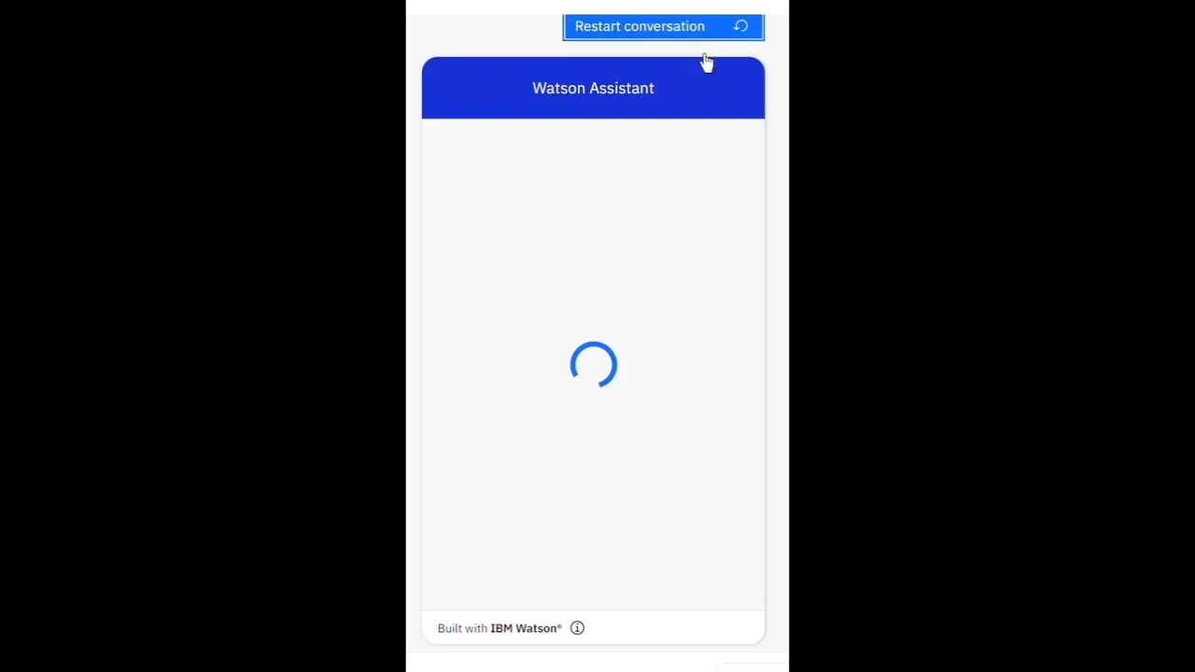
Chatbot by following the logic of the system

Slide 9
03
Decision Maker
Orion
Notes:
Now lets look at how we leverage user preferences and make effective investment strategies using our decision maker Orion.

Slide 10
How Decision Maker Orion Works
Visualize Return Simulations
03
Load Chatbot Assistant User Preferences into the Decision Maker Orion.
01
02
Decision Maker Orion Calculates the Best Investment Plan
Notes:
Our model Orion consists of three parts. User preferences loading into the decision maker, and then the decision maker will calculate the best investment plan, finally users will have insights on how their investments would perform given the periods.

Slide 11
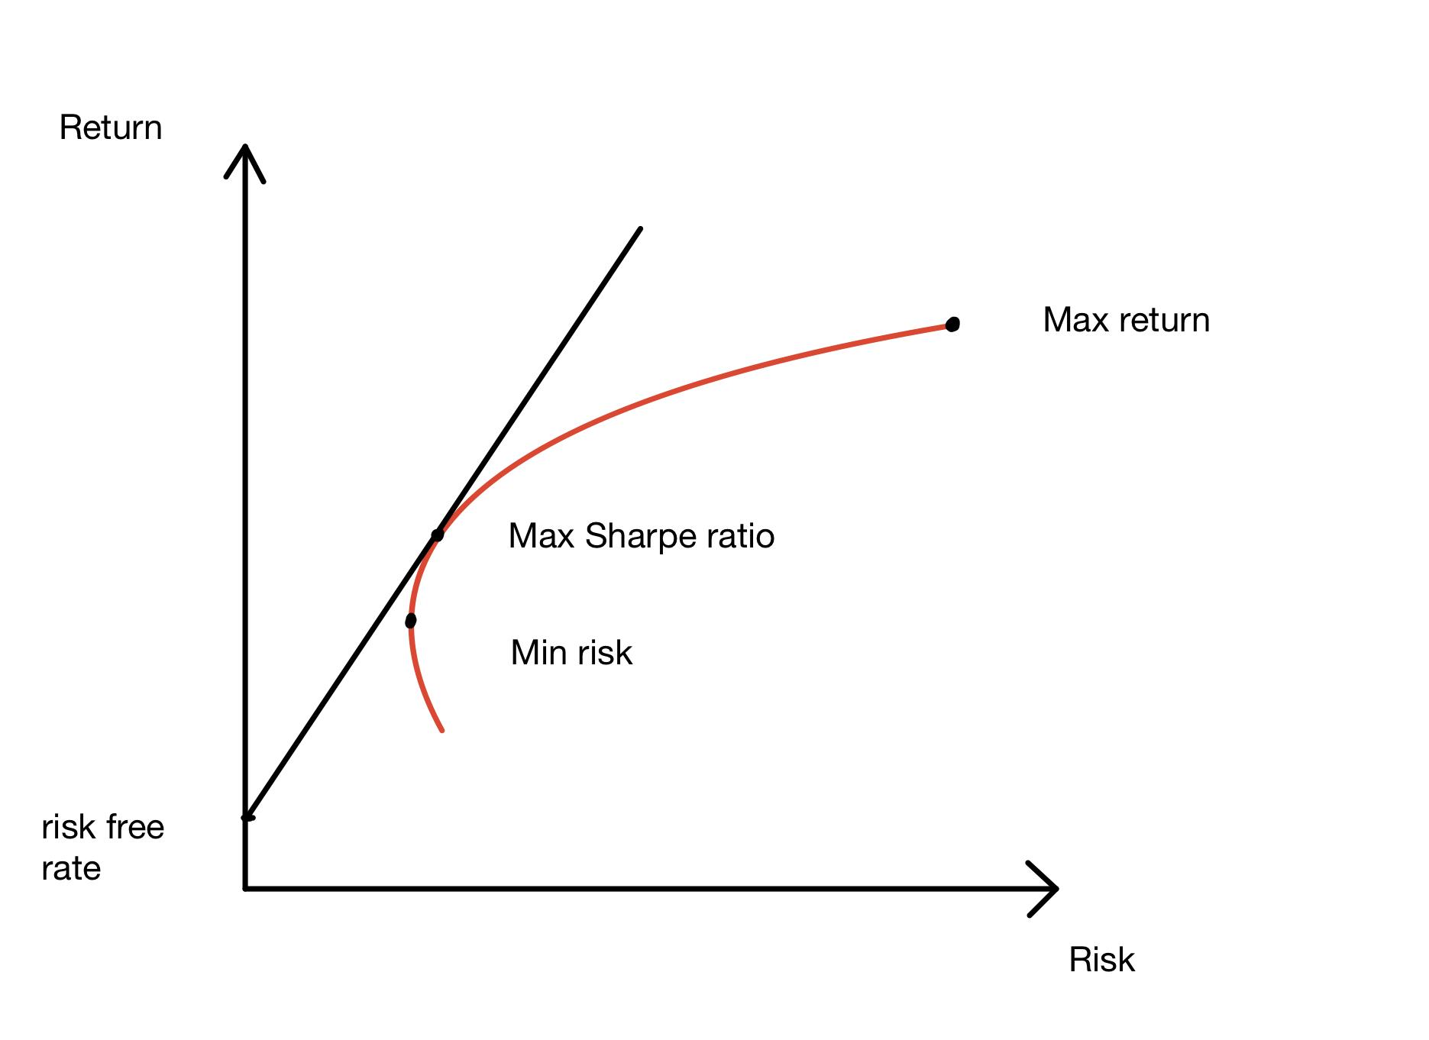
Strategies Derivation
Medium Risk, Medium Return
Low Risk, Low Return
High Risk, High Return
Notes:
Based on user preferences, we have three portfolio strategies corresponding to each of them. Minimum variance, max sharpe ratio, and max return portfolio, respectively.

Slide 12
Let’s see what the results are
for different Risk and Return Preferences!
4. Result
We assume user inputs are:
Initial cash = $10,000
Holding period = 50 days
Asset recommendations
SPY, VTV, VUG, GOVT, EEMV, CBOE, QQQ
Notes:
We generated three instances. We assume the inputs are initial cash of 10,000 dollars, holding periods of 50 days, and provided with asset recommendations.

Slide 13
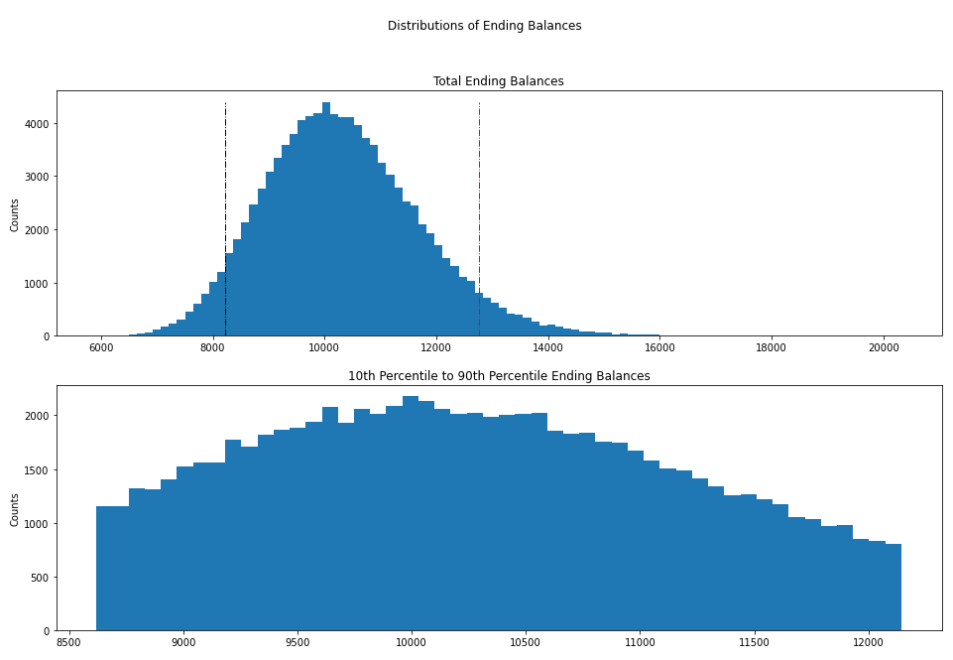
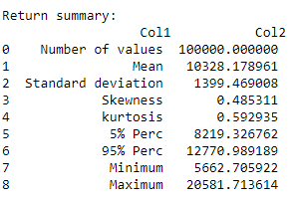
We assume user inputs are:
initial cash = $10,000
holding period = 50 days
needs for asset recommendation
Prefers low risk and low return
Results
Use Case 1: Low Risk, Low Return Preference
Outputs: Cash Allocation
$8431.7 in VUG
$1215 in CBOE
$248.98 in VTV
$104.32 in SPY
Notes:
With low risk and low return preference and all other inputs hold, we can see that most of the money is allocated into VUG, the basket of large growth stocks. It is suitable for passive investors to gain a low risk, well-diversified large growth and cost efficient portfolio.
Based on the cash allocation and holding the investment for 50 days, the algorithm simulates the portfolio to have ending balances between $5,600 and $20,000.

Slide 14
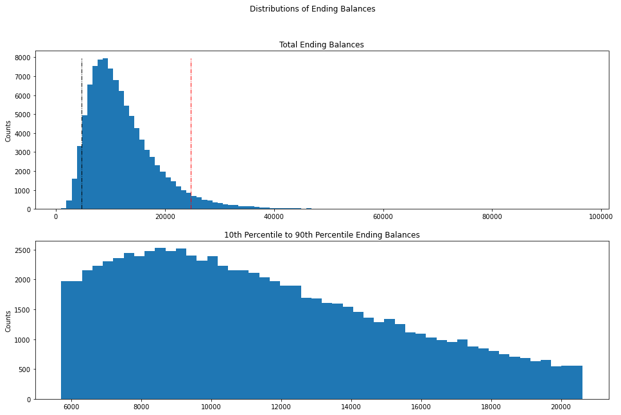
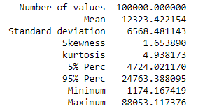
We assume user inputs are:
initial cash = $10,000
holding period = 50 days
needs for asset recommendation
Prefers medium risk and medium return
Results
Use Case 2: Medium Risk, Medium Return Preference
Outputs: Cash Allocation
$7915.21 in CBOE
$2084.79 in GOVT
Notes:
With a medium risk preference and all other inputs hold, the chatbot suggests that most cash should be allocated into the CBOE Global, which is poised for effective capital deployment and profitable on high trading volumes in index options and volatility products [4].
Based on the cash allocation and holding the investment for 50 days, the algorithm simulates the portfolio to have ending balances between $1,100 and $88,000.

Slide 15
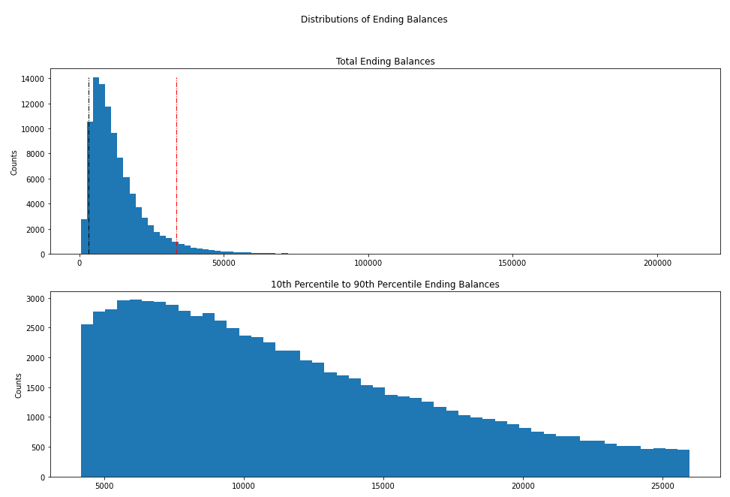
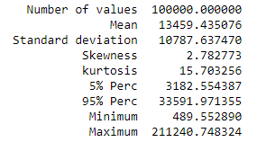
We assume user inputs are:
initial cash = $10,000
holding period = 50 days
needs for asset recommendation
Prefers medium risk and medium return
Results
Use Case 3: High Risk, High Return Preference
Outputs: Cash Allocation
$10,000 in GOVT
Notes:
With a high risk and high return preference and all other inputs hold, the chatbot suggests the user to invest almost all cash into GOVT, which indicates performance of the overall US Treasury market [5]. Although the GOVT is not considered as high risk from intuition, but the ETF indeed leads to relatively higher return during this volatile market.
Based on the cash allocation and holding the investment for 50 days, the algorithm simulates the portfolio to have ending balances between $500 and $211,000.

Slide 16
References
[1] IBM Cloud Docs. (n.d.). Retrieved April 17, 2022, from https://cloud.ibm.com/docs/assistant?topic=assistant-getting-started
[2] ISO 9241-210:2019 Ergonomics of human-system interaction — Part 210: Human-centred design for interactive systems
[3] Spy: SPDR S&P 500 ETF trust overview. MarketWatch. (n.d.). Retrieved April 17, 2022, from https://www.marketwatch.com/investing/fund/spy
[4] Cboe Global Markets. Retrieved April 17, 2022, from https://www.cboe.com/
[5] Ishares U.S. treasury bond ETF: Govt. BlackRock. (n.d.). Retrieved April 17, 2022, from https://www.ishares.com/us/products/239468/ishares-us-treasury-bond-etf
Notes:
Here are our references.

Slide 17
Thank you!
Notes:
This is the end of our presentation. Thank you for your listening and have a great evening!

